Slide 1
The Software Industry
(Based on slides by Prof. Dr. Dirk Riehle)
Licensed under CC BY 4.0 International
Notes:
It is Friedrich-Alexander University Erlangen-Nürnberg – FAU, in short.
Corporate identity wants us to say “Friedrich-Alexander University”.

Slide 2
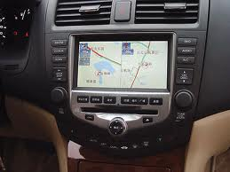
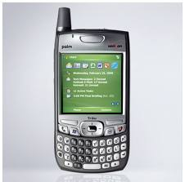


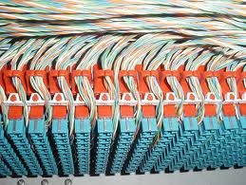
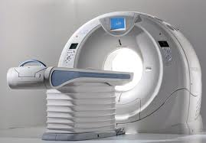
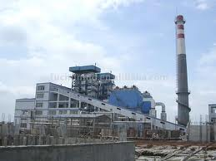
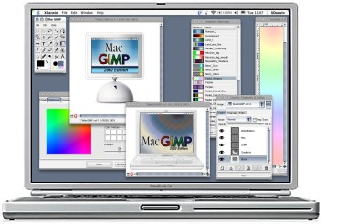
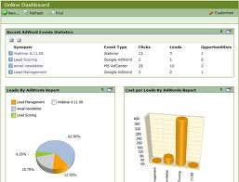
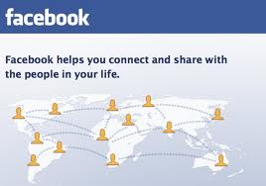
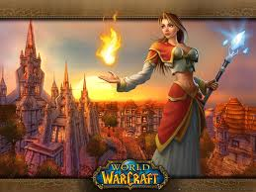
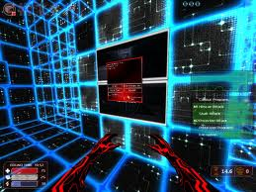

Slide 3
The Software Industry
The software industry
  Is the set of business that provide
    Software products and
    Software services such as
      Operating services
      Consulting services
        Development services
        Implementation services
  to other industries as well as itself
The software industry
  Is highly concentrated
  Is highly internationalized
  Has strong network effects
  Has a high speed of innovation
  Is rapidly expanding into new domains

Slide 4
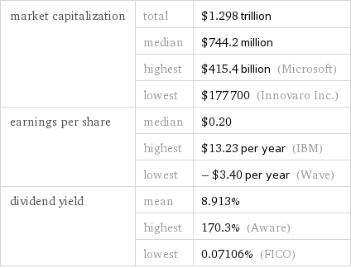
The Software Industry in 2016 [1]
[1] https://www.wolframalpha.com/input/?i=how+big+is+the+software+industry
[1] https://www.wolframalpha.com/input/?i=how+big+is+the+software+industry

Slide 5
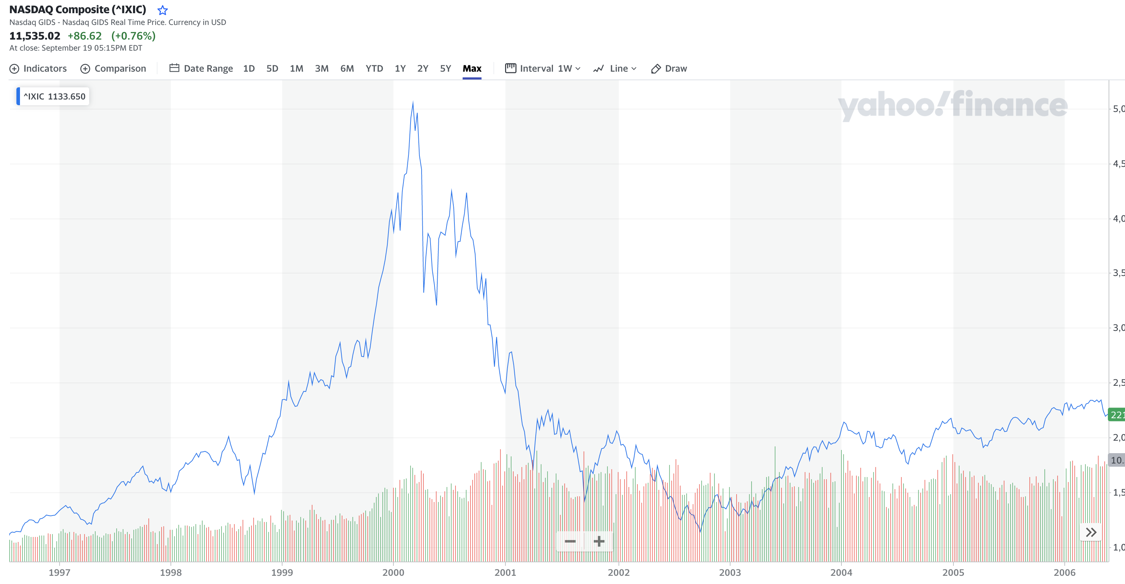
The So-called “Dot-Com” Bubble and Burst (1995-2000)
Public domain image taken from Wikipedia at https://en.wikipedia.org/wiki/File:Nasdaq_Composite_dot-com_bubble.svg

Slide 6
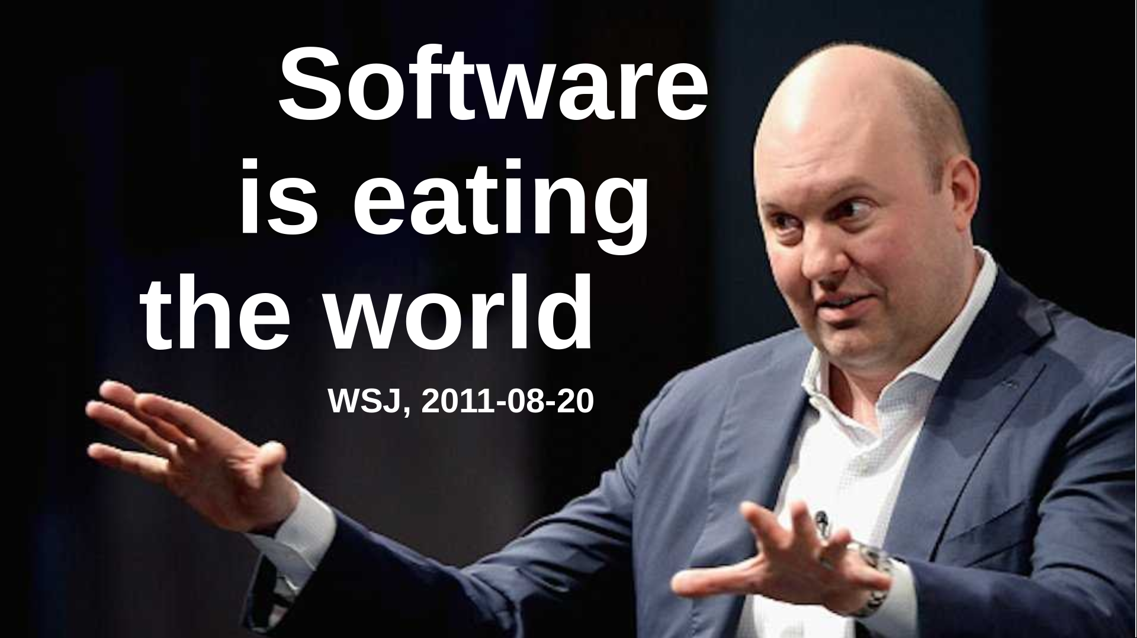

Slide 7
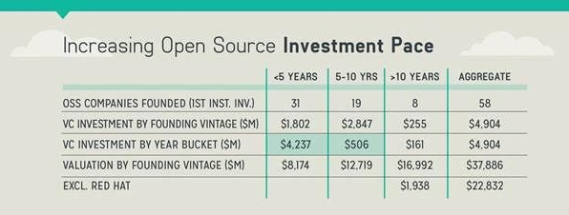
Venture Capital and Open Source (Recap)
“It is actually open source software
that’s eating the world.” [V15]

Slide 8
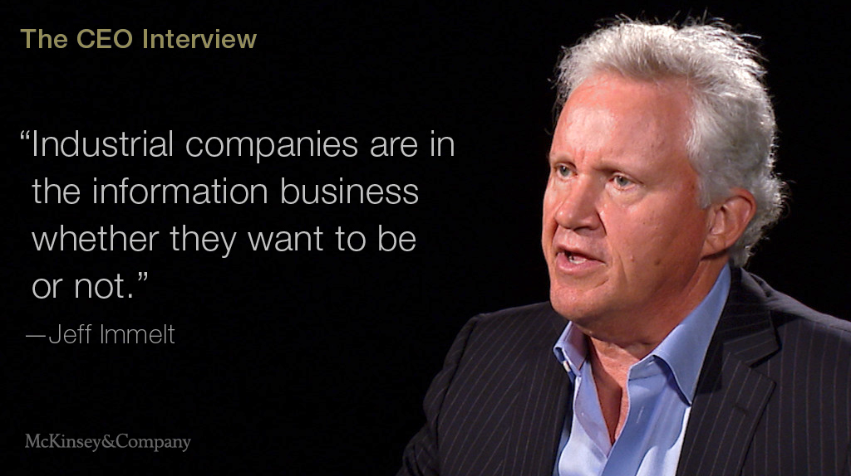

Slide 9
Short History of the Software Industry
1959
  First mentioning of term “software”
1969
  US DoJ separates hard- from software
1980ties
  From vertical to horizontal integration
  Growth of platforms and ecosystems
1990ties
  Centralization, dominance of Windows
2000ties
  Diversification, multiple platforms
  Growth of open source software
2010ties
  Back to vertical, cloud computing

Slide 10
Main Industry Players
Software vendors
  Produce products
    A.k.a. “standard software” or “commercial off-the-shelf software” (COTS)
Operating services firms
  Operate any form of software (and hardware)
Development services firms
  Produce custom software
Implementation services firms
  Adjust software products for use by customers
Regulatory bodies

Slide 11
Software is a Digital Good
Digital good
  A digital artifact satisfying a human need
  Without further intervention
    No or low reproduction costs
    Perfect reproduction possible
Software as a digital good
  Typically high cost to first copy
  Typically high switching costs
Examples
  Consumer software (Games, social media, etc.)
  Enterprise software (SAP Business Suite, Oracle RDBMS, etc.)

Slide 12
Software as a Product
Product
  A man-made good sold to customers in a market
Software as a product
  A product sold to either enterprise or retail customers
  What is sold is a license, a usage right, plus services
Characteristics
  Has an open-ended life-cycle: Is born, may life forever
  Typically requires upfront capital investment (development)

Slide 13
Core, Basic, and Whole Product
Core product =
  Core software
Basic product = bundle of
  Software + complementary materials + self-help services
  Guarantees about fitness for use + indemnification
  Support services
Whole product = basic product +
  Training
  Consulting
  Operations
For more, see our Product Management course

Slide 14
Whole product
Basic product
Usage rights
Software (core product)
Core software
Additional software (extensions + plug-
ins, tools and utiltiies, integrations)
Complementary materials
Documentation
Training materials
Self-help services
Forums, mailing lists
Help and chat agents
On-line tutorials
Pricing of usage rights
Quantity: User, machine, time, …
Duration: Perpetual, time-limited, …
Structured: Initial license fee, regular maintenance fee
Guarantees (“insurance”)
Fitness for use, certification
Indemnification
Support services
Hot-line support
On-site servicing
Pricing of guarantees
By damage: Loss of business, fines received
Structured: Levels / bands, formula
Pricing of support services (SLAs)
By availability: Incident-based, 9x5, 24x7
By quality: First-level, second-level, third-level
Training
In-house training
Off-site training
Consulting
Technical implementation services
Strategic solution consulting
Operations
Provision of SaaS (managed service)
Pricing of training
Fixed fee
Per participating person
Pricing of consulting
Fixed fee
Time and materials
Pricing of operations
Quantity: Users, resources, …
Duration: Always time-limited
Structured: Set-up, subscription

Slide 15
Commercial Open Source Products [WR13]
Web Store
Direct Sales
DOC
Documentation
INC
Incident-based support
Open Source
Community
DOC
INC
UTIL
UTIL
Utilities
LIC
Commercial license
Enterprise
Customers
LIC
UPD
UTIL
DOC
TRN
24x7
UPD
Update service
TRN
Training
ISV/OEM
LIC
UTIL
...
DOC
TRN
24x7
24x7
24x7 hot-line

Slide 16
Enterprise Customers vs. Private Users
Enterprise customers
  Are willing to trade money for time
Private users
  Are willing to trade time for money

Slide 17
Products, Projects, and Services
Products are provided by a software vendor
  “Standardsoftware”, (commercial) off-the-shelf software (COTS)
Products can be operated by service providers
  Service providers specialize in specific products
Projects are performed by consulting firms
  “Individualsoftware”, custom software
Many companies do all of the above

Slide 18
Single Product Sale Revenue
one-time license sale
revenue
initial
one-time
license fee
annual maintenance fee (~20% of initial fee)
1
2
3
4
5
time

Slide 19
Accumulating Product Revenues (SaaS) [1]
one license sale per year
revenue
1
2
3
4
5
time
[1] In SaaS, first-year license fee equals maintenance fee

Slide 20
Software Projects
Projects
  A process with a defined start and a defined end
Software projects
  Revenues correlate with performed labor
    Fixed price vs. actual labor
  Accounted for as revenue and expenses
Examples
  Bachelor and Master theses
  Customizing SAP for a customer

Slide 21
Product Revenue
Project Revenue
one license sale
one project sale
revenue
revenue
1
2
3
4
time
5
1
2
3
4
time
5
one license sale / year
one project sale / year
revenue
revenue
1
2
3
4
time
5
1
2
3
4
time
5

Slide 22



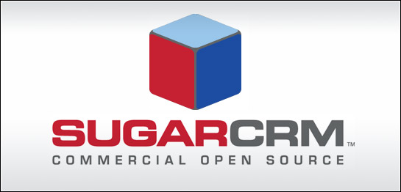



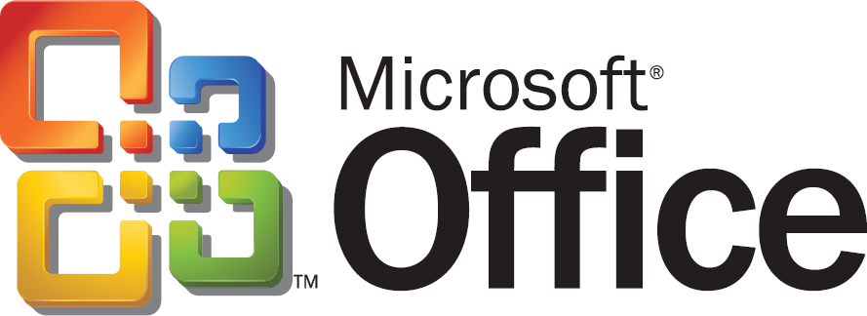

(Software) Products and (Implementation) Projects
Software
Vendor
Product
Consulting
Firm
Project
Widget Corp.
BI Impl. 2008
German SME
Sugar 2010
Continental
Stages 2010

Slide 23
Software Product vs. Project Companies
Consulting Firms
(Custom Development)
Software Vendors
(COTS Development)
Not capital intensive
Can be started easily
Stable maintenance revenue
High market capitalization
Advantages
Somewhat fragile revenue
Little long-term stability
High business volatility
Limited scalability
Hard to get started
Requires upfront investment
May be slow to react
Most fail, few survive
Disadvantages

Slide 24
Customers Buy a “Solution”
Services
Application
Operating System
Hardware

Slide 25
Vertical Integration (Until 1980ties)
IBM
DEC
Services
Services
Application
Application
Operating System
Operating System
Hardware
Hardware

Slide 26
Horizontal Integration (Since 1990ties)
Services
IBM
Accenture
Tata
Application
Microsoft Word
GIMP
Twitter
Operating
System
Windows
Linux
OS X
Hardware
IBM
Dell
Samsung

Slide 27
Categories of Software Products
Applications
  Software that is not built upon
  Top-layer of the solution stack
Platforms
  Software that is built upon
  Everything that is not the top layer
Why does everyone want to be a platform?

Slide 28
Software Platform 1 / 2
application
application
...
application
platform, for example, operating system

Slide 29
Software Platform 2 / 2
Software platform
  Is an environment for the development and deployment of applications
    Implies split between applications on top of the platform
  Is a full set of application-independent life-cycle functions for applications
    Among many components, the largest collection (i.e. not just a library)
Customer (user) value of software platforms
  By definition, a platform in itself is useless
  Customer value is only created by applications

Slide 30
Software Platforms as a Product
Platforms are valuable
  Platforms are needed by the applications running on top of it
  Platforms can simplify IT department operations costs
An application license sale implies a platform sale

Slide 31
Software Ecosystem
Software ecosystem
  The totality of actors (businesses and individuals),
  software applications and components,
  their relationships and goals
  around a software platform
Includes but is not limited to a community

Slide 32
Pricing Power 1 / 2
Application
Money spent on solution
Platform

Slide 33
Pricing Power 2 / 2
Commercial
application
In-house
application
...
IBM Websphere
Money spent on solution
Oracle RDBMS
Microsoft Windows
Not drawn to scale

Slide 34
Software Ecosystem
Software ecosystem
  The totality of actors (businesses and individuals),
  software applications and components,
  their relationships and goals
  for a software platform

Slide 35
The Software Ecosystem Wars
Total solution market
Total solution market
Ecosystem 1
Ecosystem 2
E 1
Ecosystem 2
Application
$$$$$
Application
$$$$$
A
$$$
Application
$$$$$
Total market size
Platform
Platform
Platform
$$$
$$$
P
$
$$$$$
Two competing platforms
with equal ecosystem size
Dominant platform
with larger ecosystem size

Slide 36
Open Source in the Ecosystem Wars
Total solution market
Total solution market
Ecosystem 1
Ecosystem 2
E 1
Ecosystem 2
Device
$$$$
Device
$$$$$$
D
$$
Device
$$$$$$$$
Total market size
Microsoft
Windows
$$$$
MW
$$
Linux
$$
Linux
$$$
Embedded devices
Windows vs. Linux
Embedded devices
Windows vs. Linux
Not drawn to scale

Slide 37
Business Model
A business model
  Is a summary description (model) of how a business’ elements and their relationships interact to help the business achieve its strategic goals
  Example elements are products, partners, people, positions, etc. and example relationships are the processes that govern their interaction
But “open source is not a business model” [A08]
  But open source can be a key enabler of a business model
  So much so that the business model is called “open source”

Slide 38
Key
Activities
Customer Relationships
Key Partners
Customer Segments
Value
Proposition
Key Re-sources
Channels
Cost Structure
Revenue Streams

Slide 39
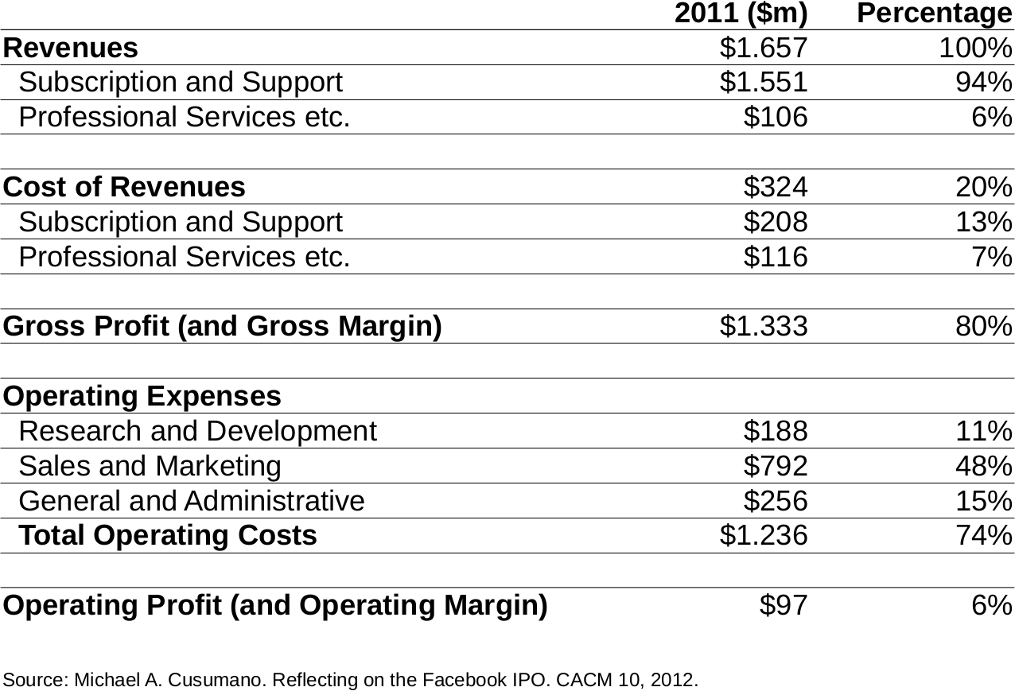

Slide 40
Open Source “Business Models”
Non-profit open source
  Community projects without foundation
  Open source developer foundations
  Open source user foundations
For-profit open source
  Service and support firms
  Open source distributor firms
  Single-vendor open source firms

Slide 41
Open Source and Business Models
Open source may not be a business model, but it may be …
  A go-to-market strategy
  An innovation model
  A collaboration model
  A sourcing strategy
  And many other things
More on this in later lectures on open source business models

Slide 42
Review / Summary of Session
The software industry
Software platforms
Software ecosystems
Business models

Slide 43
Credits and License
Original version
  © 2012-2019 Dirk Riehle, some rights reserved
  Licensed under Creative Commons Attribution 4.0 International License
Contributions
  ...

